Slide 1

Coaching The Intern
robsteed@adventist.org.au http://vicpastors.adventist.org.au

Slide 2
The Big Ideas on Coaching
Ministers who receive coach support are more successful.
Ministers achieve more when they are coach like in their leadership.
Interns self-awareness and self-mastery develop more quickly when coached.

Slide 3
In this session
Look at why coaching?
What is Christian Coaching?
The process and skills of coaching.
Coaching Interns.
Common coaching issues.
Your coaching practice.

Slide 4
Why Coaching?

Slide 5
Reasons For Coaching
Burnout: 23% church leaders in Australia are burnout. NCLS
Depressed: 1/3 of ministers experience work related depression and feel lonely. CRA 2007
Untapped Resource: 30% of the congregation do 80% of the work.
Lack of Implementation: 60% Failure to execute.
Giftedness: Finding Work Effectiveness & Satisfaction.

Slide 6
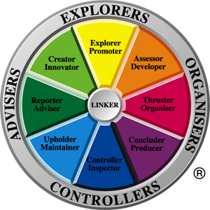
Fact 5: Giftedness: Work Effectiveness & Satisfaction.
Everyone has ‘work preferences’
Our work satisfaction depends on working in our preferred area most of the time.
Good leaders build around them balance teams.
Coaches can help build balance in a leader.

Slide 7
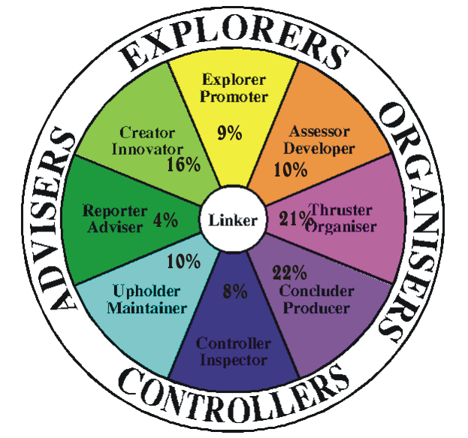
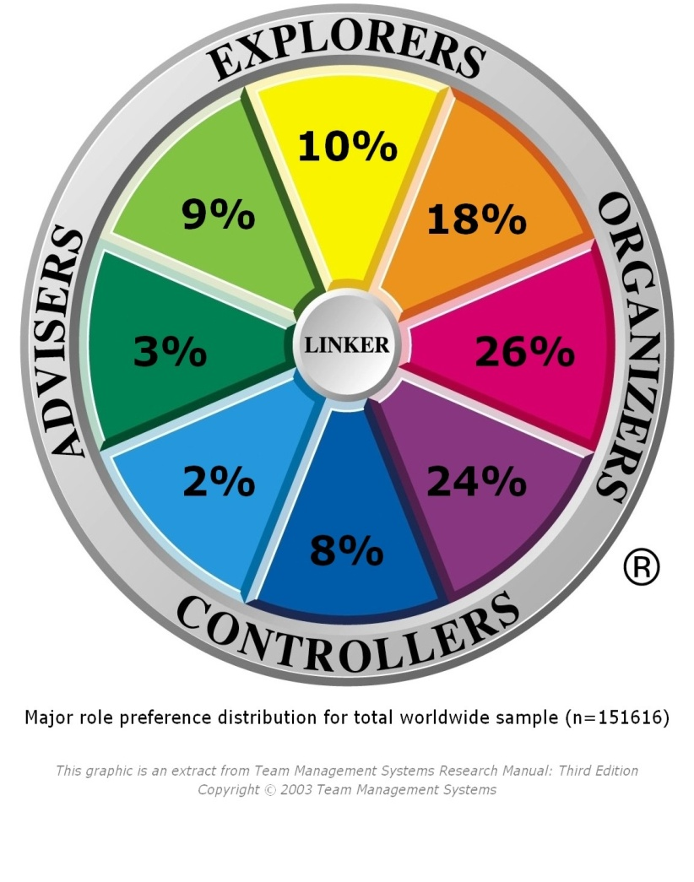
SDA Minister Distribution
N=141 SDA ministers (Australia)

Slide 8
Reasons For Coaching
Burnout: 23% church leaders in Australia are burnout. NCLS
Depressed: 1/3 of ministers experience work related depression and feel lonely. CRA 2007
Untapped Resource: 30% of the congregation do 80% of the work.
Lack of Implementation: 60% Failure to execute.
Giftedness: Finding Work Effectiveness & Satisfaction.
Training and Coaching: Coaching increases training outcomes eight fold.

Slide 9
Optimistic pastoral leader
Essential that Interns learn to be optimistic leaders

Slide 10
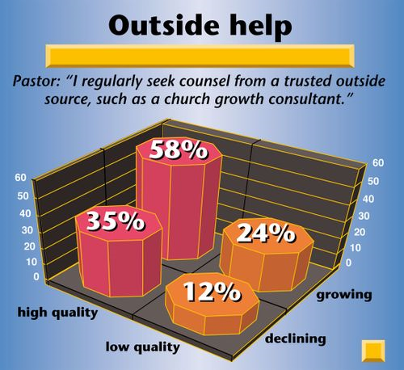
NCD - Highest Leadership Correlation with Health and Growth
“Among the fifteen variables related to leadership, the factor with the strongest correlation to the overall quality and growth of a church, is the readiness to accept help from the outside.”

Slide 11
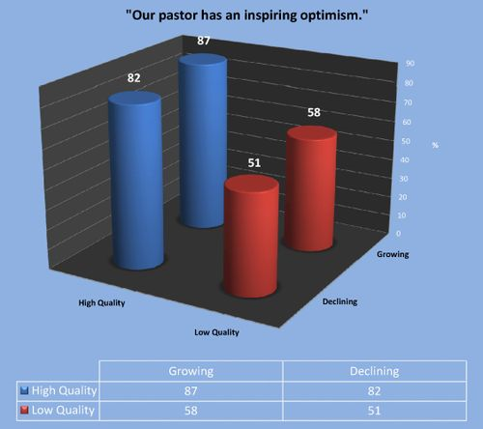
NCD - Highest Leadership Correlation with Health and Growth
"outside help" is no longer the item with the highest correlation with growth and quality.
Number one is the item "Our pastor has an inspiring optimism.”
and number two is the item "Our pastor concentrates on the tasks in the church for which he is gifted.”
Notes:
Empowering Leadership Revisited (4)
As I showed in my last blog entry, "outside help" is no longer the item with the highest correlation with growth and quality. So what is it now, based on data from about 60,000 NCD surveys?
Number one is the item "Our pastor has an inspiring optimism." (r=0.655, p=0.000), and number two is the item "Our pastor concentrates on the tasks in the church for which he is gifted." (r=0.592, p=0.000). Both items are from the co-workers questionnaire.

Slide 12
Optimistic pastoral leaders
“Optimistic managers are more likely to be engaged managers who are more likely to engage employees; engaged employees, in turn, are more optimistic and productive than disengaged employees, and their increased productivity increases profitability. What's more, says Greenberg, "Researchers have found that optimistic people are more successful, healthier, and happier" -- attributes that can also contribute to organizational productivity and profitability.” Jennifer Robison Gallup Management Journal.

Slide 13
How to pour optimism into interns
Disputing
Reframing
Active-constructive Responding
Notes:
: Disputing involves refuting pessimistic notions -- whether they are your own or those of others -- with realistic counter-arguments. Even a pessimist can learn to pause, think, and marshal reasonable denials to other pessimists, including himself.
: Reframing involves finding the original, beneficial intent behind an action, then using it to change a behavior. The manager of a team facing layoffs, for example, can position the event as doomsday, or she can point out that the company has to cut costs or go out of business. The first frame invites employees to panic; the second can help them respond calmly and rationally to a bad situation.
: Active-constructive responding is a way of listening to others' good news that encourages them to savor the positive emotion. It's as simple as the difference between responding, "That's nice" when a coworker tells you about his latest success, or saying, "Wow, that's great! Tell me more about how you accomplished that." It's also an infectious behavior -- the active-constructive responder gleans a little of the emotional high, and the person with the good news develops an even higher opinion of the responder.
Jennifer Robison is a Senior Editor for the Gallup Management Journal. http://gmj.gallup.com/content/28303/pays-optimistic.aspx

Slide 14
Reasons For Coaching
Burnout: 23% church leaders in Australia are burnout. NCLS
Depressed: 1/3 of ministers experience work related depression and feel lonely. CRA 2007
Untapped Resource: 30% of the congregation do 80% of the work.
Lack of Implementation: 60% Failure to execute.
Giftedness: Finding Work Effectiveness & Satisfaction.
Training and Coaching: Coaching increases training outcomes eight fold.
Coaching Leader: Enabling leaders are more effective.

Slide 15
Enabling Pastoral Leaders
Interns need to experience what it means to be enabled tin their ministry

Slide 16

Coaching and Contented Cows –
Bill Catlette and Richard Hadden
“How does one organization achieve sustained success while seemingly identical competitors are struggling?”
Notes:
Workplace studies have repeatedly shown that most people could, by their own admission, contribute significantly more effort to their jobs if they really wanted to. Residing within each of us is a reservoir of effort that remains entirely under our personal control... Discretionary Effort. It dwells in the gap between what's required of us and what we're actually capable of. We call it Oomph! Good leaders at every level strive daily to get the benefit of that extra effort. Contented Cows MOOve Faster is about how they do it, and how you can do it. It is about real people with real jobs going the extra mile, and the leadership behaviors that cause them to want to do it.

Slide 17
Coaching and Contented Cows
“Regardless of the industry, it is no accident that the organizations consistently identified as winners in their chosen field also happen to be some of the best places on earth to work.”
A survey by New York's Families and Work Institute asked employees in a wide variety of industries and vocations, "What's important in your job?" The top ranked answer was "Open Communication".

Slide 18
Coaching and Contented Cows
Let's be clear, coaching, above all else, is about communicating. Good coaches are honest and open, sometimes uncomfortably so, as they work to help people achieve their full potential.
“…In almost every case, Contented Cow companies were led, from top to bottom, by people who communicate more like coaches, and less like managers and bosses.”

Slide 19
How Do Contented Cows Coaches Do It?
Contented Cow companies get their people Committed, You can't boss someone into commitment. Bosses get, at best, compliance; coaches get commitment.
Contented Cow employees know that they are cared about. People simply perform better for you when they know you care.

Slide 20
How Do Contented Cows Coaches Do It?
3. Contented Cow employees are enabled. A good coach provides this enablement by giving people at least three things:
  Tools.
  Trust.
  Training.
Notes:
Contented Cow employees are enabled. Notice we didn't say "empowered". Employees are empowered already, by virtue of their jobs, if we would just get off their necks long enough to let them do their jobs. A good coach provides this enablement by giving people at least three things:
Tools. That means both equipment and systems... especially systems. Do you tell people it's important to do something, and make it nigh unto impossible for them to do it? Eg. Credit Card meal Reciepts
Trust. You'll get what you expect to get. Coaches expect a lot, because they're clear about roles, expectations, and performance.
Training. Dispensing with training after a bad fiscal quarter is fundamentally stupid. No one ever dug out of an earnings hole by "dumbing down" their workforce. Every good coach knows it's much better to coach a talented, Committed (there's that word again) team than to boss a bunch of people who are at best confused, and worse, confounded, about what they're supposed to be doing, or why they are doing it.

Slide 21
Evaluate your Coaching Exercise
How good are you at
developing Commitment?
How well do you Care for
Your Intern?
Rate your Enabling ability:
(Tools, Trust & Training)
Poor 1 – 2 – 3 – 4 – 5 – 6 – 7 – 8 – 9 – 10 High
Poor 1 – 2 – 3 – 4 – 5 – 6 – 7 – 8 – 9 – 10 High
Poor 1 – 2 – 3 – 4 – 5 – 6 – 7 – 8 – 9 – 10 High

Slide 22

Intern Development
Ministry
Tasks?
Personal
Development?
Notes:
Ministry Tasks - Preaching - Committee work – Visitation – Outreach – Teaching - Counselling
Time management - Work balance - People skills - Leadership skills - Life style balance – Preaching – Committee work – Visitation – Counselling -

Slide 23
Intern Development
Ministry
Tasks?
Personal
Development?
Notes:
Ministry Tasks - Preaching - Committee work – Visitation – Outreach – Teaching - Counselling
Time management - Work balance - People skills - Leadership skills - Life style balance – Preaching – Committee work – Visitation – Counselling -

Slide 24
2. Coaching Makes A Difference

Slide 25
Greg Pratt – Associate Pastor
“I have found coaching leaders really is empowering leadership at its best! It has not only transformed and taken my leadership and ministry to whole new level but also the church and it leaders. There is nothing more exciting than seeing church members and leaders realise their God given potential, become equipped and begin leading in a way that really does change people’s lives for eternity.” Greg Pratt 2010

Slide 26

Darren Slade – A Coaching Pastor
Question: You have been a recipient of coaching and received coach training. How has this altered the way you relate to your leaders now?

Slide 27
Darren Slade – A Coaching Pastor
Answer: Quite a big shift for me – I now see leaders as one of my church’s best resources if trained and empowered. I feel it is important to spend far more time with my leaders than I have before, and I am constantly looking to help them to step up, and I want to be there to encourage and support. I am not a perfect leader to my leaders, but I feel that my coaching has dramatically increased my awareness and it is up to me to make my leaders a priority in the same way my coach has made me his priority.

Slide 28
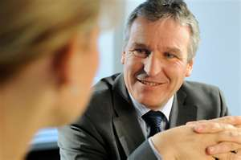

The Multiplying aspect of coaching
Mentor – Intern
Experiencing Coaching
Intern – Member
Being A Coach
Notes:
Two aspects of coaching:

Slide 29
Characteristics of Christian Coaching

Slide 30
Characteristics of Coaching
The focus is on the future: is about designing a future, not getting over the past.
The relationship is typically long-term: support and progress require time.
The goals, dreams, and visions drive the action: discovering what they want.

Slide 31
Characteristics of Coaching
There are multiple paths to reach each want: there is always a way to progress.
The client knows the way (even though he or she may not realize it at the time): choosing solutions is the client’s responsibility. Partick Williams & Deborah C Davis, Therapist as Life Coach: Transforming Your Practice

Slide 32
Characteristics of Christian Coaching
Christian coaching is the process of coming alongside a leader to help them discover God’s agenda for their life, and then to co-operate with the Holy Spirit to see that agenda become a reality.

Slide 33
Christian Coaching
“… the ability to have a heart posture towards another that is genuinely and authentically for them.” This ‘heart posture’ relationship is the energy source for change. This ‘heart posture’ of the coach is but a reflection of “…the heart of the Father for all his created children, a heart that is the source of transformation.” (Joseph Umidi Transformational Coaching P22)

Slide 34
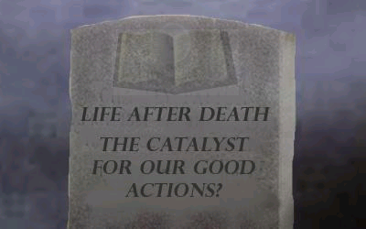
Christian Coaching
Provides perspective power- Reminds us who we are.
Eternal significance – sets the ‘bar’ at eternity.
Optimistic, passionate people.

Slide 35
Life Plan – Living according to our Values
It is when personal values, work values or church values conflict that people experience stress and loss motivation.
The coach needs to assist clients to identify such clashes and determine the validity of the values they are operating by and those that they are in conflict with.

Slide 36
Positional Relationship
Different ways of relating to the Intern

Slide 37
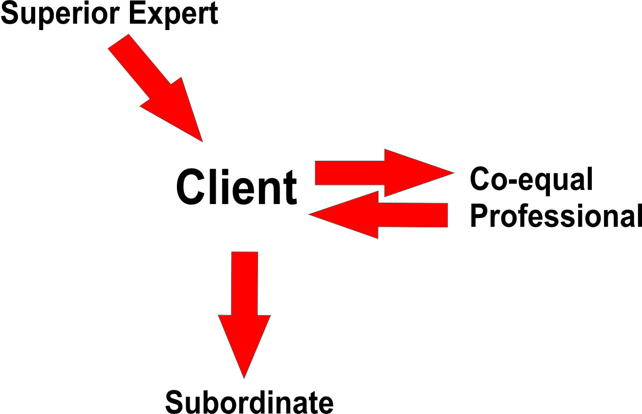
Three Positional Relationships

Slide 38
Continuum Of Coaching
Coaching
Leader
Supervisory
Organizational
Coaching
Mentor
Superior
Role
Personal
Coach
Co-equal
Relationship
Relationship
Accountability

Slide 39
Coaching the Individual
Understanding Human Behaviour

Slide 40
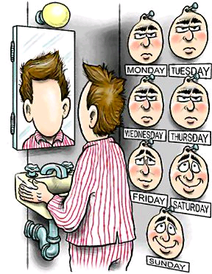
People are complex

Slide 41
Understanding Human Behavior
Self-awareness level
Breadth of Perspective
Personal Values
Unmet Personal Needs
Nothing better to do
Rigid, self-defining roles
Addictions, compulsions
Emotional damage, triggers
Tradition and status quo
Personality type
Upbringing and family
Assumptions and beliefs
Models and examples
Notes:
1. Self-awareness level:
Self-awareness is your ability to feel, see and understand who you are, where you are coming from, what you are doing, why you are doing it, how you come across and what your body, spirit and mind is experiencing and tell you.
Through self-awareness you come to know yourself and understand why things happen they way they do, including your own reactions, and you tend to make better choices that fit well.
Without self-awareness, one tends to repeat patterns, ignore intuition and miss out on the rich subtleties that life provides.
A coach can help a coachee increase their awareness.
2. Breadth of Perspective:
Perspective is both the angle you see yourself and life from, and also the viewing height.
The higher the perspective, the clearer the view.
Narrow perspective results in:
Lack of context | Single paradigm | Self-referencing
Minimal understanding | Small choices | Reactions
A coach helps clients increase perspective by asking challenging questions, introducing paradoxes, distinguishing distinctions and co-creating stimulating environments that expand thinking.
3. Personal Values:
Values are personal priorities – that which is most important to you, for whatever reason.
There are hundreds of values; each is valid.
Values are sometimes hidden by unmet needs.
Discovering one’s values affords alignment and integration and reduces life stress.
When values are clear, fulfillment occurs.
A coach can help a coachee discover and orient them self and their life around their personal values.
4. Unmet Personal Needs:
Unmet needs causes a person to spend 10-95% of their time/life expensively chasing people and events to get these needs met.
Personal problems and delayed development occur when needs are treated like options, instead of like true needs.
Needs are not personal; they are just needs.
Needs are “satisfy-able” once they are discovered.
There are 100’s of needs; pick 3 or 4.
When you satisfy needs, you have more time and more space to enjoy your life.
A coach helps you identify and satisfy your needs.
5. Nothing better to do:
Humans default to the familiar, even if lame or proven not to work.
If you want to change, make the need, cost or opportunity for the change compelling - really compelling.
Changing your environment can quickly give you something worth doing.
Coaching works because it creates a wide enough gap so that the person has a reason to change, go for something or to evolve.
6. Rigid, self-defining roles:
Many people define themselves by roles.
Roles then dictate thinking, priorities and behaviour, sometimes at great cost/loss.
Roles are tribal in origin and thus survival-based.
You are more than your roles in life.
You can become role-free and yet fulfill your obligations.
A coach helps a coachee release restricting roles, integrate larger/evocative roles and operate independently from roles.
7. Addictions, compulsions: As life becomes more complex and stressed, addictions
and compulsions provide welcome numbing and diversion, but at the high price of
loss of choice. A coach can help a client see where they are being driven/controlled;
a counsellor or therapist provides recovery assistance.
In2action Christian Coach Network
8. Emotional damage triggers: Our past hurts and experiences can reduce our ability
to deal with the present. These memories can be very debilitating emotionally. The
coach may help to identify such triggers and help the client to manage them more
appropriately.
9. Tradition and status quo: People are comfortable in the "old ways" they provide a
sense of identity. However, tradition can be limiting and cause irrelevance. A coach
helps a person to develop their own traditions and helps the client to replace tribe
with community.
10. Personality type: It is very difficult to change one's personality it is better to
accept who you are and leverage from your strengths. The more you know about
how you operate the easier it is to accept yourself and others. A coach helps a client
make the most of their personality type.
11. Upbringing and family: Our early years dictate our way of thinking, perceiving
and relating. Familial expectations and rules become deeply embedded and can take
years/decades to release. Rejecting your upbringing/family usually doesn’t release
their effects on you; better to accept and integrate all that occurred and then evolve.
12. Assumptions and beliefs: Assumptions are beliefs that we have internalized. We
order our lives around them. Problems occur when our assumptions are wrong. A
coach can help a client reorient around values.
13. Models and examples: Copying others and working from models can save time
and build confidence. A coach has scores of life models that expand a client’s
thinking and awareness and thus their choice of goals and approach to reaching those
goals.

Slide 42
Understanding Human Behavior
Wants and desires
Support structures
Rewards and incentives
Vision, possibility
Resources, tools
Lifestyle
Living environment
Work environment
Fears
Unclear identity
“Availability heuristics” (bigger picture)
Ignorance
Preferences
Notes:
14. Wants and desires:
Desire is genetically wired in, and attempts to control or suppress it can be quite expensive.
Wants usually come from unmet needs.
Better to first come to understand the source and nature of your desires (intellectual, physical, emotional and/or sexual).
Desire is energy and can be channeled to your advantage.
Desire is a wonderful thing, not a bad thing.
If desires become unmanageable, then they have become compulsions.
15. Support structures:
The more personal and professional support we have, the more we can achieve with less stress.
In an increasingly chaotic world, structure provides a necessary framework, personal attention and a system to get things done.
As humans become more creative and experiment more in new areas, endorsement, encouragement and collaboration provide a baseline of support.
A coach provides the proper amount of support and structure that empowers vs. restricts or overwhelms.
16. Rewards and incentives:
Humans are easily motivated with the most fitting carrot or stick; if in doubt, ask the person.
Your carrot is not my carrot; your stick is not my stick.
The more evolved a person is, inspiration usually works better than incentives.
We are subject to subliminal and primal messages via advertising, all of which reduce our ability to choose freely.
Coaches can help a coachee clean up their motivators so they are healthful, natural and good for them.
17. Vision, possibility:
The clearer the vision, the more focused a person can be.
To have a vision, one needs to have a sense of possibility far beyond reasonable thinking.
A vision is one of the most powerful motivators and evolvers.
A coach can help you see your vision and begin to express it.
18. Resources and tools:
If people have the necessary money, time, space, network, style, knowledge, access, technology and/or experience, they can accomplish almost anything.
Without a critical resource or tool, people fail or don’t even start.
We all have hidden talents and resources we don’t know we have; these can be leveraged.
A coach can help a coachee make the most of what they have.
19. Lifestyle:
Having a lifestyle is something that people are either striving for or are eager to protect.
The process of designing and choosing a lifestyle is a new experience for most people.
Lifestyle has a life of its own.
Sometimes, lifestyles limit our evolution; sometimes, they accelerate our evolution.
The people your lifestyle attracts to you will affect who you are becoming and what you choose.
A coach can help a coachee simplify, customize or expand their lifestyle.
20. Living environment: Our environment, including where and who we live with
effects our life goals. Today people have much more choice over these factors. A
coach can help a client make choices as to their environmental goals.
21. Work environment: Our work takes up a large part of our life and impacts our life
satisfaction. A coach can help a client design their preferred work environment.
21. Fears: Fear of failure is stronger than the fear of not succeeding. Fear is neither
good nor bad it depends on how you use it. A coach helps a client to integrate and
use fear instead of being used by fear.
22. Unclear identity: Lack of clarity of identity can cause people to be overly
influenced by others. It can often be synonymous with low self-esteem. A therapist
can help if the unclear identity is a psychological problem. A coach can sometimes
help, using values and a “Personal Foundation Program”.
23. “Availability heuristic”: Tendency of people to focus on a single fact, element,
event rather than the bigger picture. A coach helps a client think “bigger picture.”
24. Ignorance: State of being uninformed, unaware or uneducated. A coach can help
to fill in the pockets of ignorance that we all have.
25. Preferences: Preferences usually come from a combination of influences. People
are more willing to trust their preferences (beliefs) even if not logical.
Preference-based choosing is a skill set that includes intuition, inklings, wants and
whims. A coach helps a client to get clearer on what they most want, not what they
should want, could want or used to want.

Slide 43
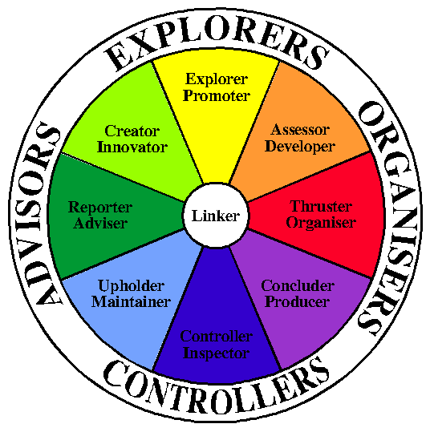
Importance of Understanding Your Work preferences
Gives you insight into you coaching style and your interns leadership style.
Enables the coach to temporarily modify their style to match that of the Intern – ‘pacing skills’.
Pacing skills are important for interns to learn.

Slide 44
Coaching Process

Slide 45
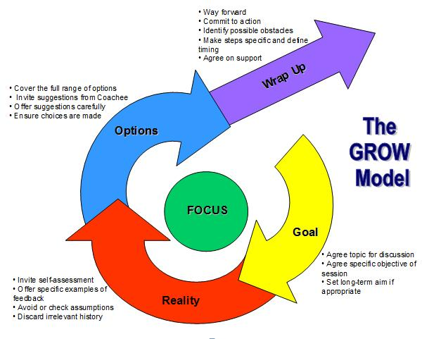
.

Slide 46

Skills
Coaching

Slide 47
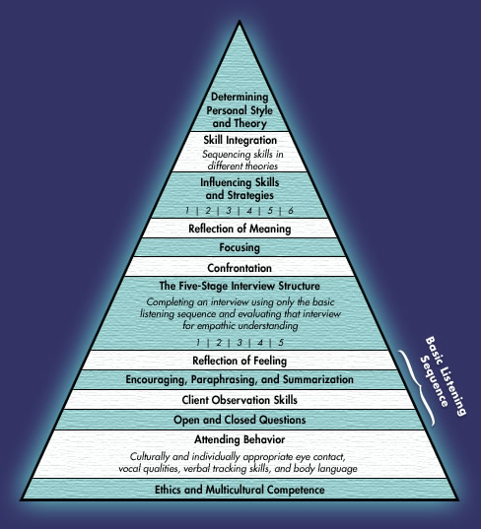
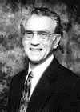
Microskills
Hierarchy
Allen Ivey

Slide 48
Deeper Understanding
“No, let us speak the truth in love; so shall we fully grow up into Christ” (Ephesians 4:15,16).
Good coaching is being able to say the truth in a way that is constructive and appropriate.

Slide 49
Deeper Understanding
The skill, ‘deeper understanding’ is the skill of helping another person to see themselves as others see them. Through deeper understanding you communicate to another person what they do not see or experience about themselves very clearly.

Slide 50
Basic Understanding Dialogue
(coachee Disclosure)
coachee: “I don’t know what’s happening in our group. I think I try as hard as everyone else, But still don’t feel like part of the group. I don’t seem to fit at all.
(Basic Understanding Response)
Coach: “It’s frustrating and depressing. You put in as much effort as everyone else, but it doesn’t seem to pay off.”

Slide 51
Deeper Understanding - Dialogue
coachee: I don’t form relationships as easily as the rest of them. It’s probably my own fault, but all my work seems to go down the drain. I don’t know what else to do.”
(Deeper Understanding Response)
Coach: “It’s discouraging to put so much effort and still feel that you’re not getting anywhere. It almost sounds to me as if you’re beginning to feel a little bit sorry for yourself and that might be making things seem even more impossible.”

Slide 52
Confrontation
On occasions, following a moment of “deeper understand” you as a coach will decide to confront your coachee with their new insight. You will summarize their discovery but in a way that also challenges them to act on it.

Slide 53
Confronting Dialogue
(Confronting Response)
coachee: “I tend to get easily discouraged when people criticize me. Well I guess it’s my own fault.
Coach: “So might it not be a good idea to make some changes in the way you handle other people’s criticism?” Would you like to do some work on that with me?”

Slide 54
Guidelines for Confrontation
1. Don’t forget plenty of basic, accurate understanding.
2. Be tentative.
3. Know why you are confronting.
4. Don’t confront until you have earned the right.
5. Don’t gang up on a person.
6. Be concrete, don’t waffle.
7. Don’t confront with only non-verbal hints.
8. Confront only for the right reasons.

Slide 55
Getting Started

Slide 56
Your coaching practice
Formalize your coaching sessions.
Meet frequently.
Keep notes of your agreements.
Meddle with intent.
Go gentle on their failings.
Work out your interns work preferences.
Affirm and celebrate your interns success.

Slide 57
The Core Concept of Coaching
Coaches are first and for most talent hunters.
Coaching holds people accountable to do something different.
Coaching connects the coachee with their heavenly reality.
Coaching helps Christian realize their full potential in Christ.
Notes:
Graham McKenzie of Hall Mark company
We know what great coaching is. I am going to challenge you to be more intentional about it.
Think what it would be like if you were the sort of person who actively sought the qualities of others in your church
Creative director of Hall Mark Cards
He would donate a day a month to schools.
I am … how many of you are artists.
1st grage 1000%
2nd 50%
6th 0%
Once in a while strange kid put up their hand.
What happen to the artist between 1st grade and 6th.
Most talent goes un developed.
Giving advice and war stories – not all that helpful. Challenging people is much more helpful than giving advice.
Letting people stay in the puddle. Help then stand up and walk out on their own.

Slide 58
“In the common walks of life there is many a toiler patiently treading the round of his daily tasks, unconscious of latent powers that, roused to action, would place him among the world’s great leaders. The touch of a skillful hand is needed to arouse and develop those dormant faculties.” Ellen White to Parents, Teachers and Students p511

Slide 59
Next Becoming A Coaching Leader Course
August 7-9
robsteed@adventist.org.au
www.vicpastors.adventist.org.au

